Slide 1
SARANYA.R(19S031) SHANTHOSH KUMAAR.S.R(19S032) SHIBANI.K.R(19S033) SHOBIKA.R(19S034) SIVA SRI VARSHINI.S(19S035)
GROUP 6
STUDY IN DETAIL CODD’S PAPER ON RELATION MODEL OF LARGE DATA
DEP : MSc. DATASCIENCE
SEM : 4

Slide 2
CONTENTS
CONTENTS
INTRODUCTION
CODD’S 12 RULES
RELATIONAL MODEL
DATA DEPENDENCIES IN PRESENT SYSTEMS
KINDS OF DATA DEPENDENCIES
RELATIONAL VIEW OF DATA
PROPERTIES OF RDM
NORMAL FORM
TYPES OF NORMAL FORM
LINGUISTIC ASPECTS
EXPRESSIBLE, NAMED AND STORED RELATIONS
OPERATIONS ON RELATIONS
PERMUTATIONS
PROJECTION
JOINS
COMPOSITION
RESTRICTION
REDUNDANCY
STRONG REDUNDANCY
WEAK REDUNDANCY
CONSISTENCY
CONCLUSION

Slide 3
INTRODUCTION
The principles of relational model were first outlined by Dr.E.F.Codd in June 1970 paper is called “A Relational Model Of Data For Large Shared Data Banks”.
In this paper Dr.Codd proposed the relational model for database system. But, its commercial implementations were observed in the 1980s.
REASON FOR THIS PAPER:
Data independence from database implementation such as machine representation.
Natural structure of data
Can be analyzed mathematically.(Codd was a mathematician by training).

Slide 4
This paper is concerned with the application of elementary relation theory. It is divided into 2 sections.
In section 1, a relational model of data is proposed as a basis for protecting users of formatted data systems from the potentially disruptive changes in data representation caused by growth in the data bank.a normal form for time-varying collection of relationships is introduced.
In section 2,certain operations on relations are discussed and applied to the problems of redundancy and consistency in the user’s model.

Slide 5
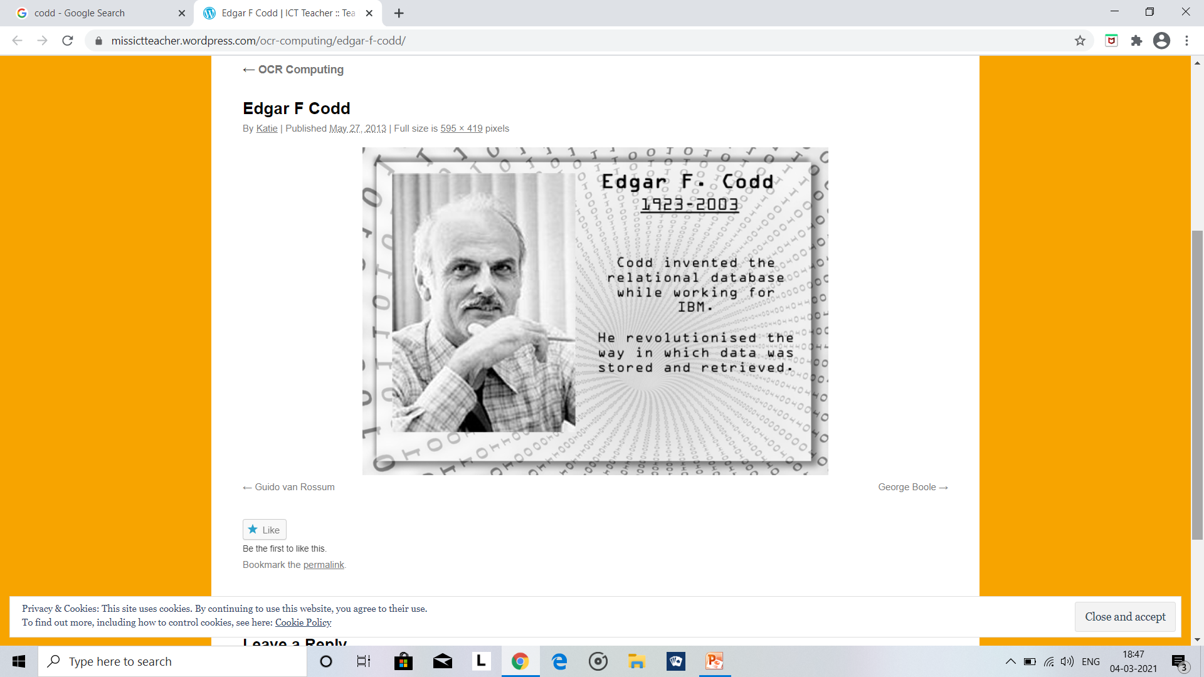
SECTION 1

Slide 6
CODD’S 12 RULES
FOUNDATION RULE: For any system that is advertised as, or claimed to be, a relational data base management system, that system must be able to manage data bases entirely through its relational capabilities.
INFORMATION RULE: Data stored in Relational model must be a value of some cell of a table.
GUARANTEED ACCESS RULE: Every data element must be accessible by table name, its primary key and name of attribute whose value is to be determined.
SYSTEMATIC TREATMENT OF NULL VALUES: NULL value in database must only correspond to missing, unknown or not applicable values.

Slide 7
CONTD….
ACTIVE ONLINE CATALOG: Structure of database must be stored in an online catalog which can be queried by authorized users.
COMPREHENSIVE DATA SUB-LANGUAGE RULE: A database should be accessible by a language supported for definition, manipulation and transaction management operation.
VIEW UPDATING RULE: Different views created for various purposes should be automatically updatable by the system.
HIGH LEVEL INSERT, UPDATE AND DELETE RULE: Relational Model should support insert, delete, update etc. operations at each level of relations. Also, set operations like Union, Intersection and minus should be supported.

Slide 8
CONTD….
PHYSICAL DATA INDEPENDENCE: Any modification in the physical location of a table should not enforce modification at application level.
LOGICAL DATA INDEPENDENCE: Any modification in logical or conceptual schema of a table should not enforce modification at application level. For example, merging of two tables into one should not affect application accessing it which is difficult to achieve.
INTEGRITY INDEPENDENCE: Integrity constraints modified at database level should not enforce modification at application level.
DISTRIBUTION INDEPENDENCE: Distribution of data over various locations should not be visible to end-users.
NON-SUBVERSION RULE: Low level access to data should not be able to bypass integrity rule to change data.

Slide 9
RELATIONAL MODEL
Relational model expresses the data and relationship among the data in the form of tables.
The relational model is also referred to as the “record based model” as it frames the database in fixed format records of various types.
The problems treated here are those data independence and data inconsistency.
“Data Independence” is a property that helps to change the Database schema at one level of a database system without requiring to change the schema at the next higher level.
“Data inconsistency” is a situation where there are multiple tables within a database that deal with the same data but may receive it from different inputs.

Slide 10
DATA DEPENDENCIES IN PRESENT SYSTEM
The data can be stored different forms of orders of the records. The application directly accesses the data in memory and therefore has to make some assumptions about how the data is organized is called as data dependencies.
There are 3 kinds of data dependencies which still need to be removed are:
1.ordering dependence
2.indexing dependence,
3.access path dependence.

Slide 11
KINDS OF DATA DEPENDENCIES
ORDERED DEPENDENCE:
The data can be stored several forms of the records. Many applications fail to differentiate between the data storage ordering and data presentation ordering as a result applications can fail if the data stored ordering has to be changed.
INDEXING DEPENDENCE:
Indexing data is with both pros and cons as it improves performance while querying and performing updates on data but they deteriorate the performance while inserting and deleting data and also is a redundant overhead. To perform well in changing patterns environment the indices need to be created and destroyed. Different applications provide different indexing properties.
ACCESS PATH DEPENDENCE:
The access paths for data are represented in tree-structures or networking model, but many applications fail if any of underlying model is altered. To deal this problem an impractical solution suggested was to not to decide an access path to be obsolete till all the application programs use the path.

Slide 12
SIMPLE EXAMPLE :
Suppose the data bank contains information about parts and projects. For each part,
the part number, part name, part description, quantity-on-hand, and quantity-on-order are recorded. For each project,
the project number, project name, project description are recorded.
Whenever a project makes use of a certain part, the quantity of that part committed to the given project is also recorded.

Slide 13
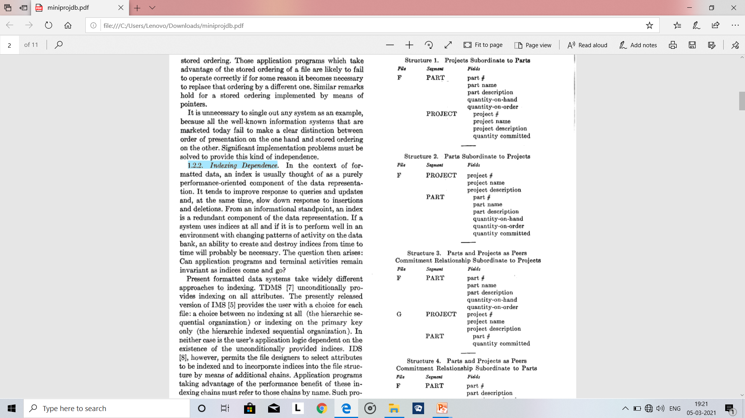
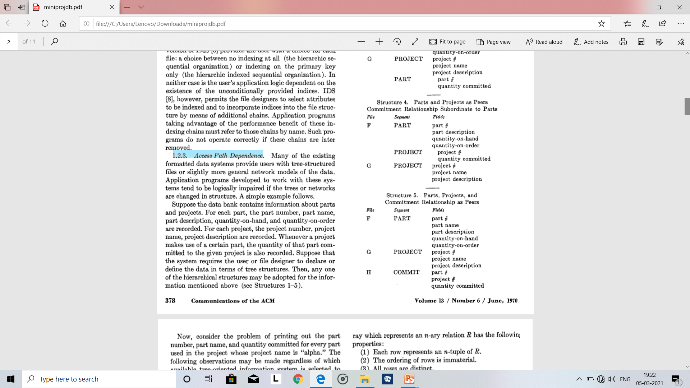
Suppose that the system requires the user or file designer to declare or define the data in terms of tree structures then, any one of the hierarchical structures(given below) may be adopted for the information mentioned above .

Slide 14
RELATIONAL VIEW OF DATA
Relational Data Model(RDM) is developed with mathematical sense.
The word “table” appears in the paper, for visual representations of relations which Codd calls as “arrays” do resemble tables.
RDM expresses the database as a set of relations( table of values).
Each relation has columns and rows which are formally called as attributes and tuples respectively.

Slide 15
CONTD….
Each table has a unique key called primary key , which identifies the information in a table.
The relationship between tables can then be set via the use of foreign keys- a field in a table that links to the primary key of another table.
A relation(R) is said to have degree “n”.
Relations with degree 1 often called unary, degree 2 as binary, degree 3 as ternary, and degree n as n-ary.

Slide 16
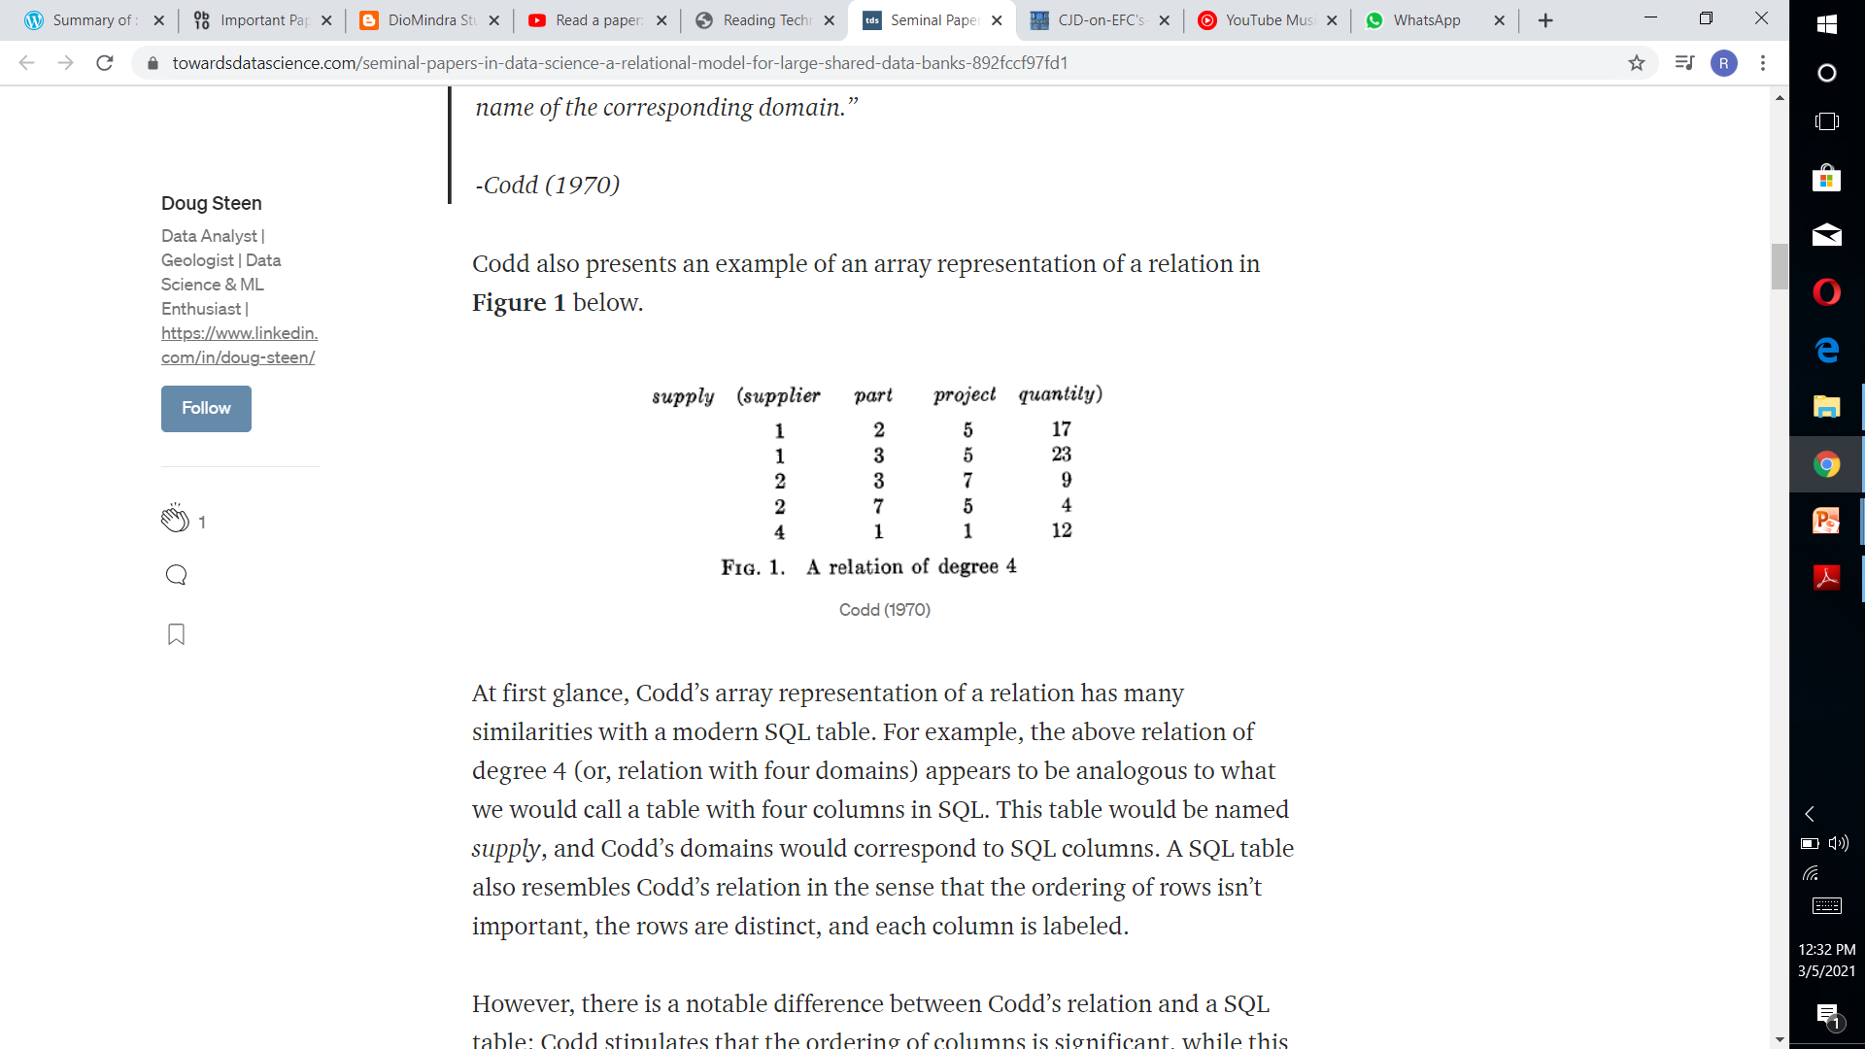
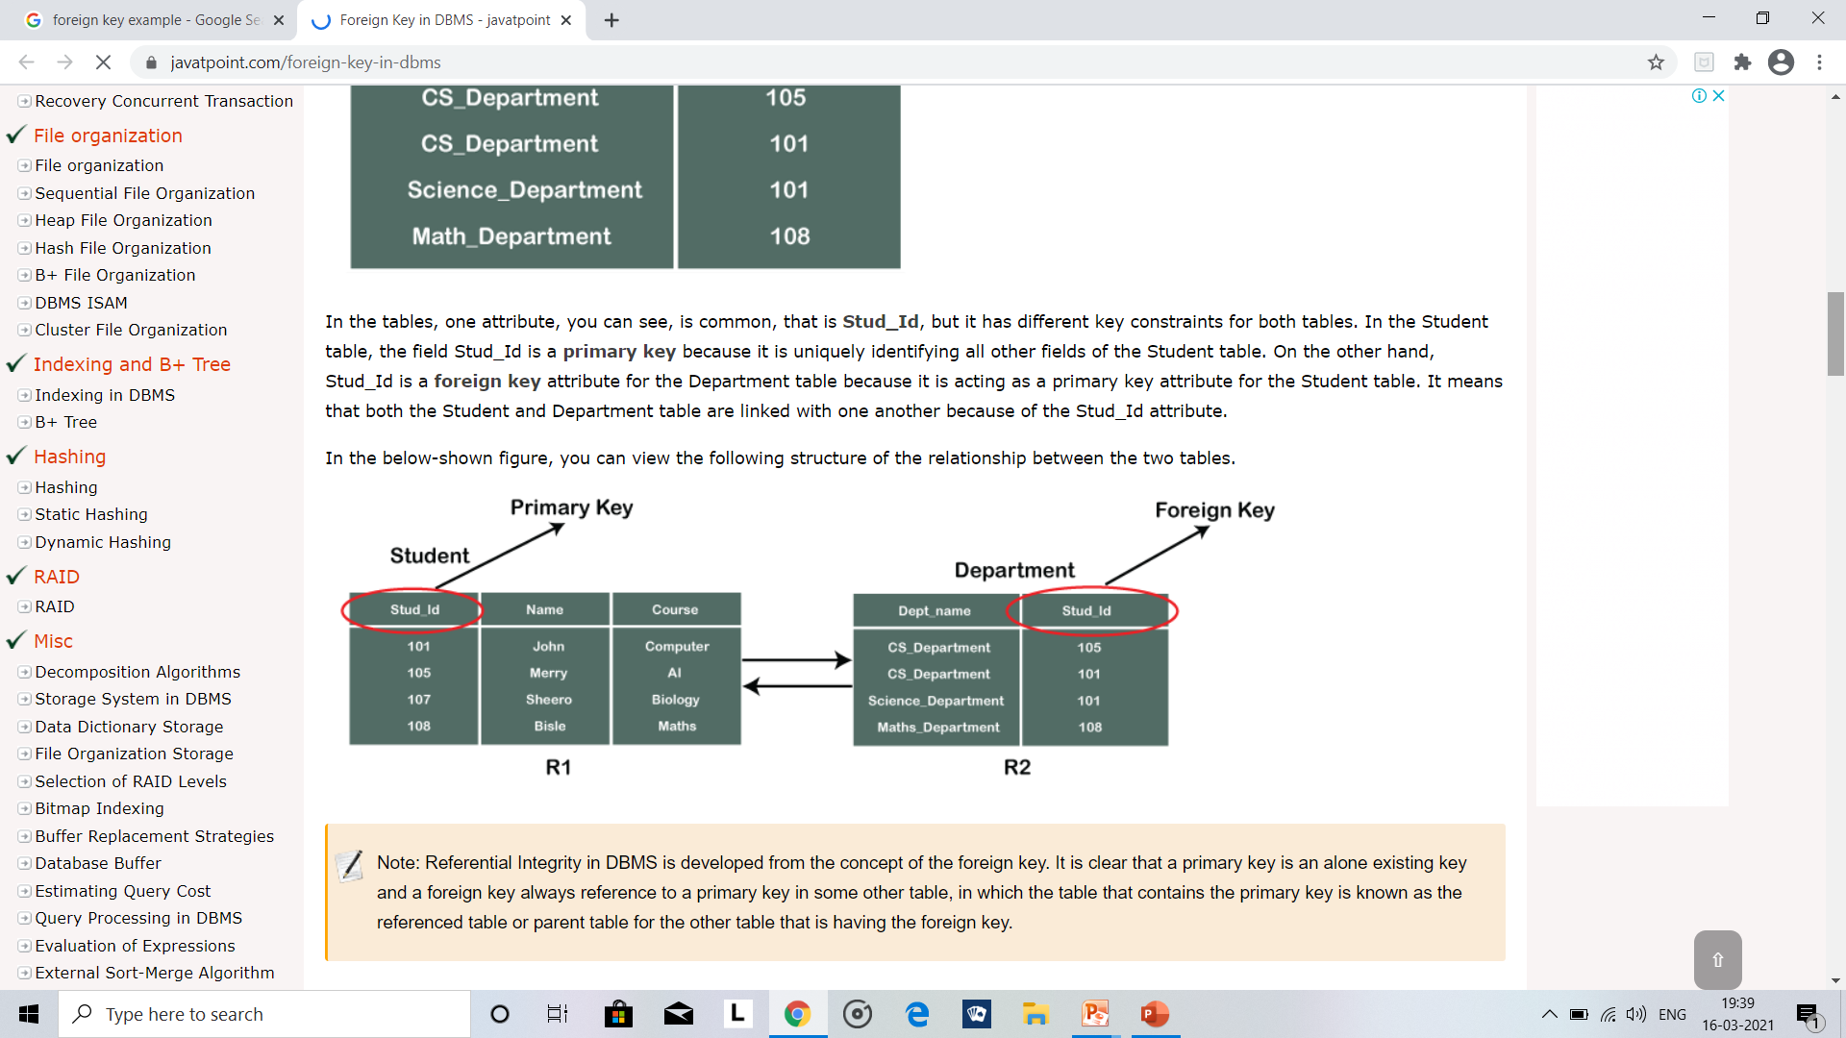
CONTD….
Let us consider an example.
In the table given ,
relation is supply
Primary key is supplier
degree is 4
Attributes are supplier, part, project, quantity
Tuples are all data inside the table
In this tables R1 and R2 ,student ,department are relation and Stud_id is the foreign key

Slide 17
PROPERTIES OF RDM
Each row represents an n-tuple of R.
The ordering of rows is immaterial.
All rows are distinct.
The ordering of columns is significant-it corresponds to the ordering S1, Sz , . . . , S, of the domains on which R is defined.
The significance of each column is partially conveyed by labeling it with the name of the corresponding domain.

Slide 18
NORMAL FORMS
When there is a large dataset and nested relation with one or more non simple domains, the possibility of eliminating non simple domains appears worth investigating.
There is, in fact, a very simple elimination procedure, which we shall be called as normalization.
Normalization proceeds as follows:
Starting with the relation at the top of the tree, take its primary key.
Expand each of the immediately subordinate relations by inserting this primary key domain or domain combination.
The primary key of each expanded relation consists of the primary key before expansion augmented by the primary key copied down from the parent relation.
Now, strike out from the parent relation all non simple domains, remove the top node of the tree.
Repeat the same sequence of operations on each remaining sub-tree.

Slide 19

CONTD….

Slide 20
CONTD….
If normalization as described above is to be applicable, the unnormalized collection of relations must satisfy the following conditions :
Unnormalized Relation doesn’t have a primary key that component domain
there exist graph instead of tree due to interrelationships of the simple domain.
Advantage of normal forms or communication form:
It would be devoid of pointers (address-valued or displacement-valued).
It would avoid all dependence on hash addressing schemes.
It would contain no indices or ordering lists
If the user's relational model is set up in normal form, names of items of data in the data bank can take a simpler form than would otherwise be the case.
A general name would take a form such as
R (g).r.d
where,
R is a relational name;
g is a generation identifier (optional);
r is a role name (optional);
d is a domain name.

Slide 21
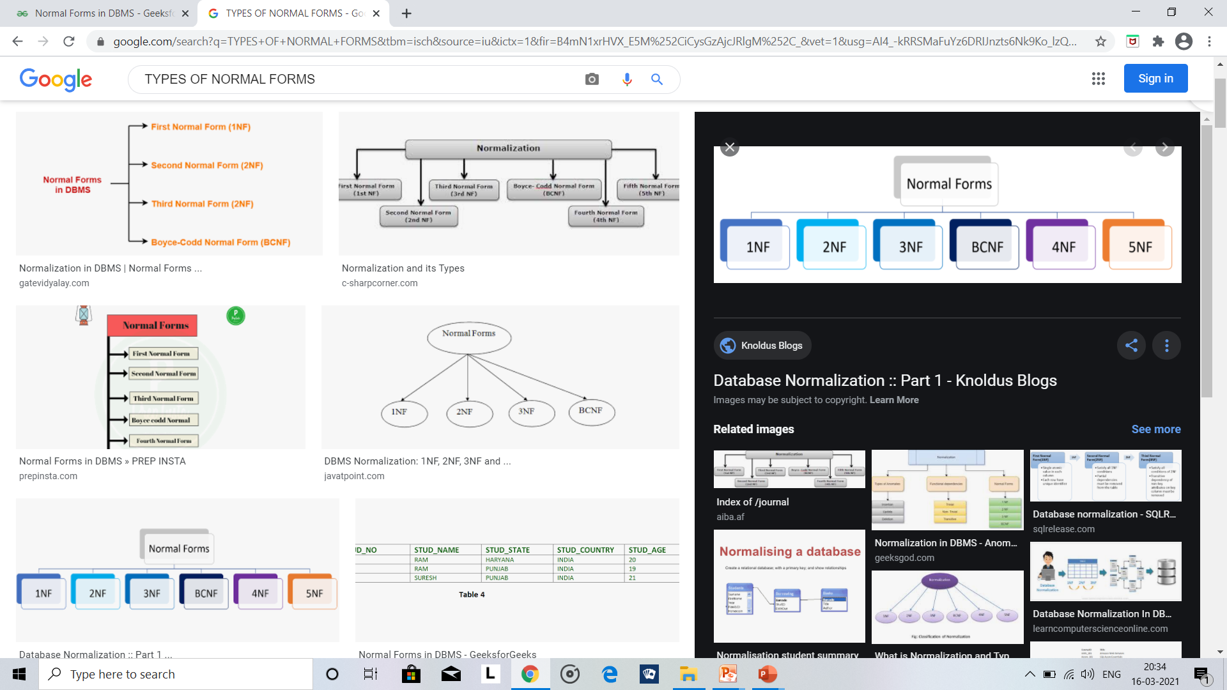
TYPES OF NORMAL FORMS
1NF:First normal form:
A relation will be 1NF if it contains an atomic value.
It states that an attribute of a table cannot hold multiple values. It must hold only single-valued attribute.
First normal form disallows the multi-valued attribute, composite attribute, and their combinations.

Slide 22
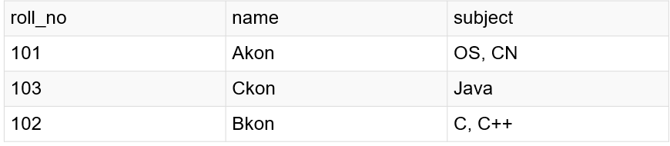
EXAMPLE
After converting into 1NF
roll_no | name | Subject
101 | Akon | OS
101 | Akon | CN
103 | Ckon | Java
102 | Bkon | C
102 | Bko | C++

Slide 23
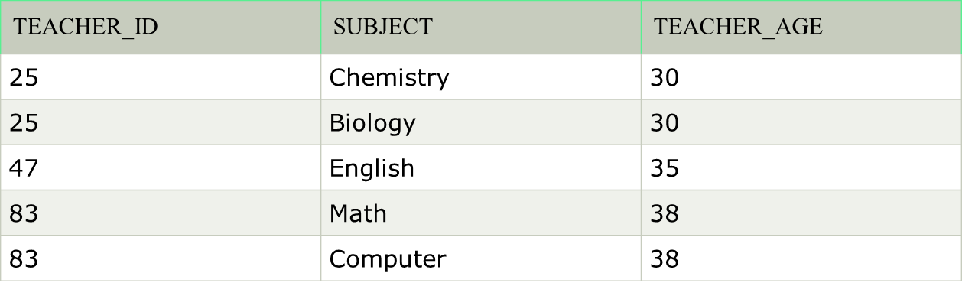
2NF:SECOND NORMAL
FORM
In the 2NF, relational must be in 1NF.
In the second normal form, all non-key attributes are fully
functional dependent on the primary key.
EXAMPLE:
To convert the given table into 2NF, we decompose it into two tables :
TEACHER_ID | SUBJECT
25 | Chemistry
25 | Biology
47 | English
83 | Math
83 | Computer
TEACHER_ID | TEACHER_AGE
25 | 30
47 | 35
83 | 38

Slide 24
3NF:THIRD NORMAL
FORM:
A relation will be in 3NF if it is in 2NF and not contain any transitive partial dependency.
If there is no transitive dependency for non-prime attributes, then the relation must be in third normal form.
A relation is in third normal form if it holds at-least one of the following conditions for every non-trivial function dependency X → Y.
X is a super key.
Y is a prime attribute, i.e., each element of Y is part of some candidate key.

Slide 25
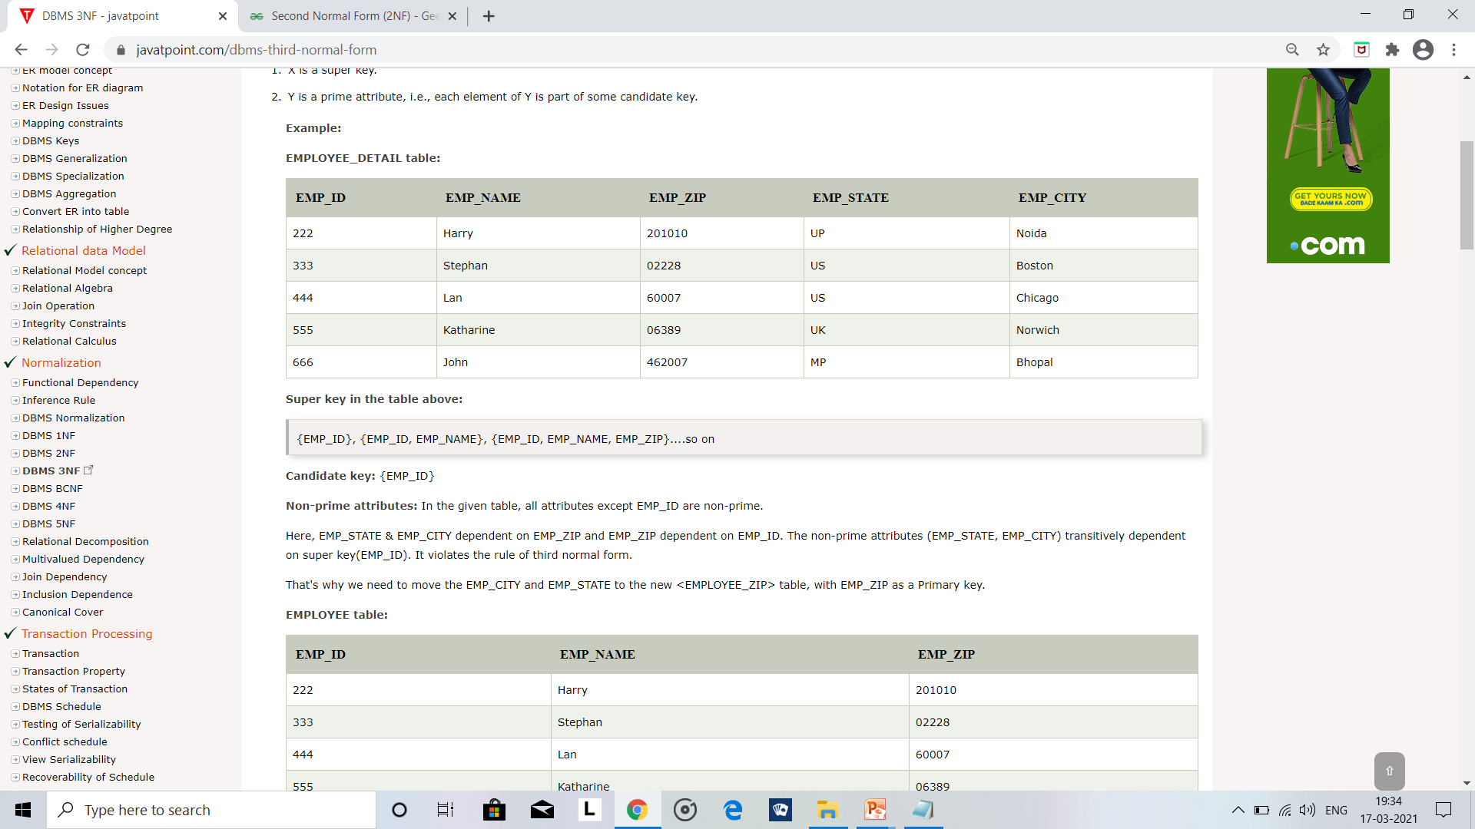
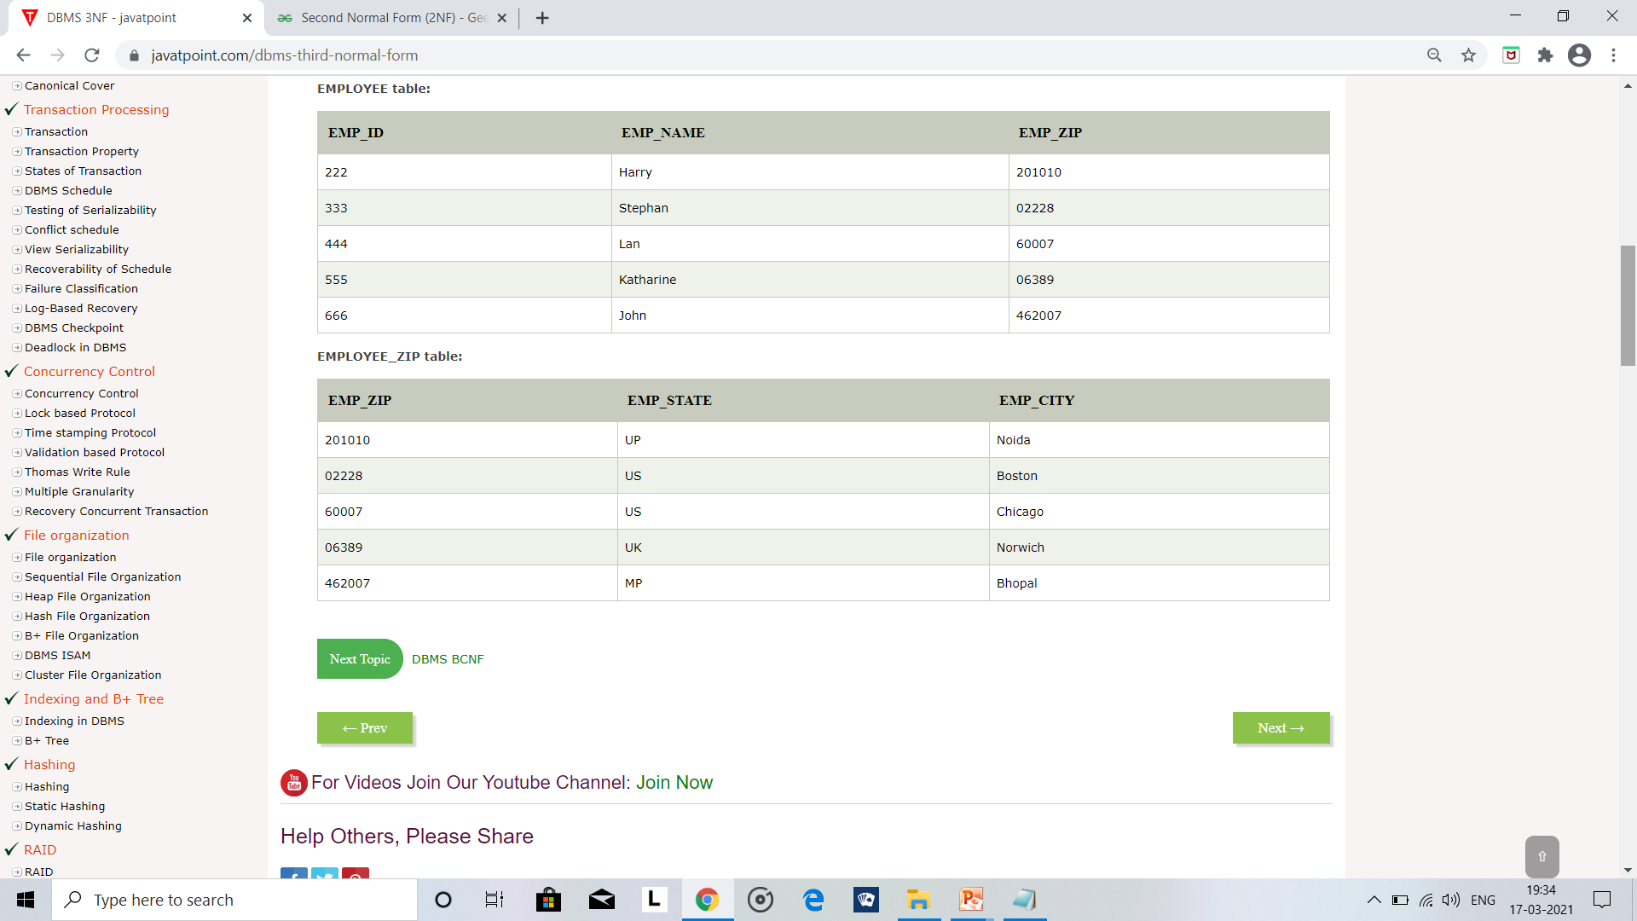
EXAMPLE
After decomposing the given table into 2 tables:

Slide 26
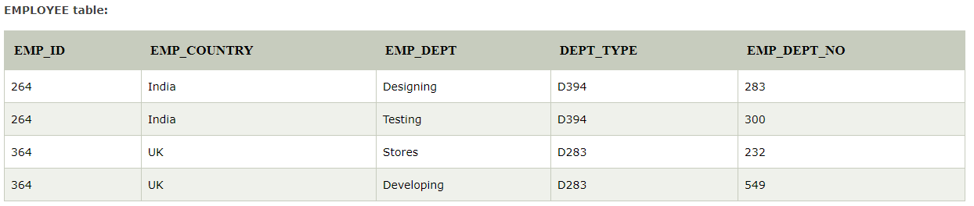
BCNF
BCNF is the advance version of 3NF. It is stricter than 3NF.
A table is in BCNF if every functional dependency X → Y, X is the super key of the table.
For BCNF, the table should be in 3NF, and for every FD, LHS is super key.
EXAMPLE:

Slide 27
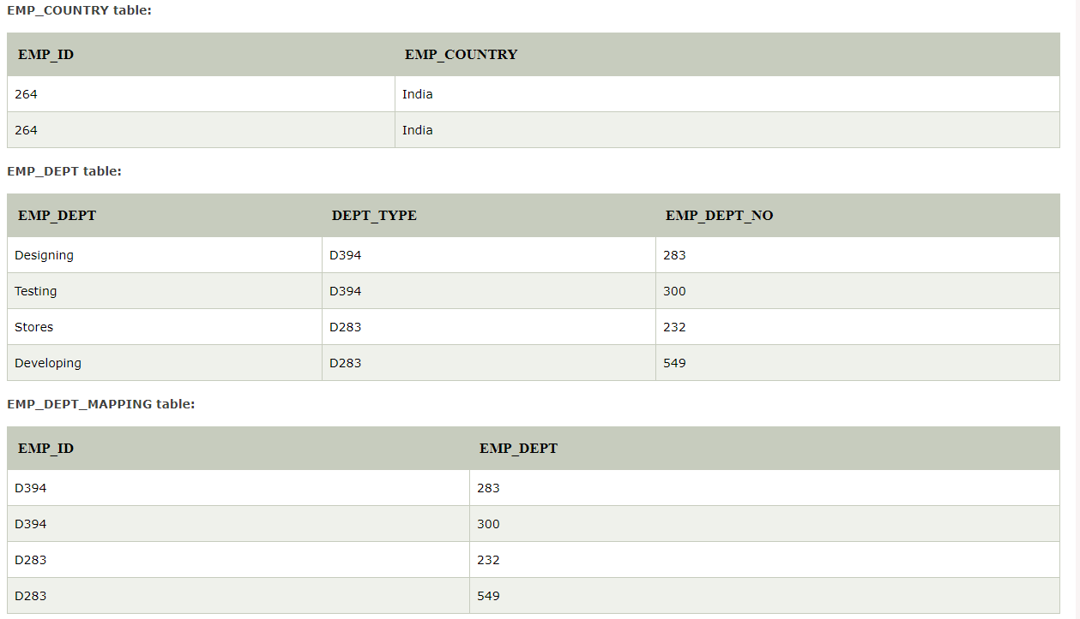
CONTD….
After decomposing the given table into 3 tables:

Slide 28
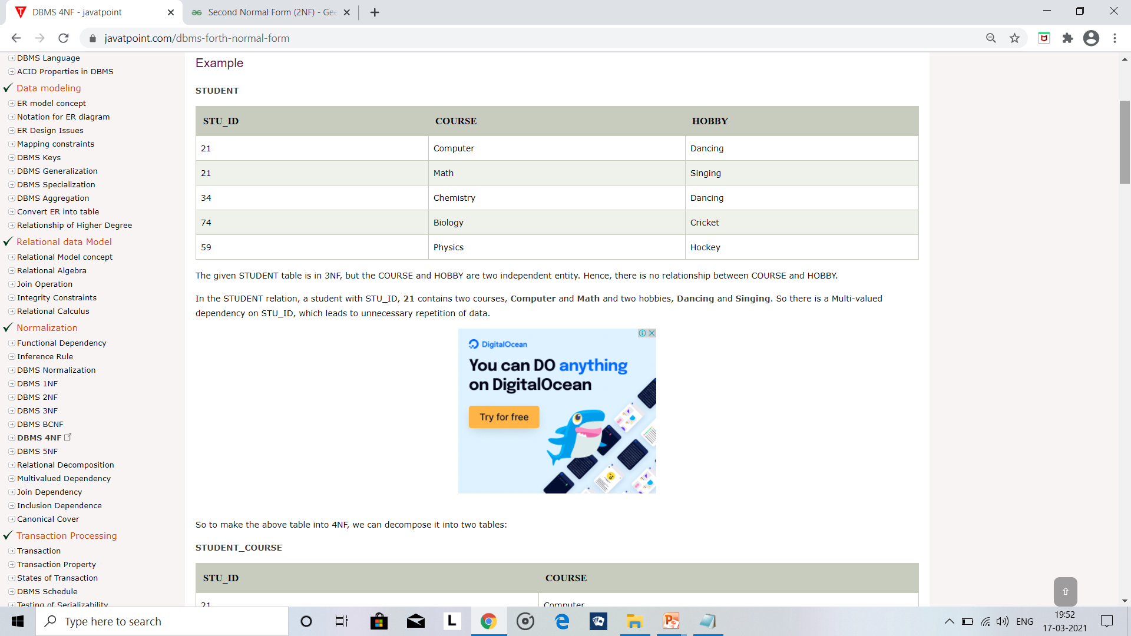
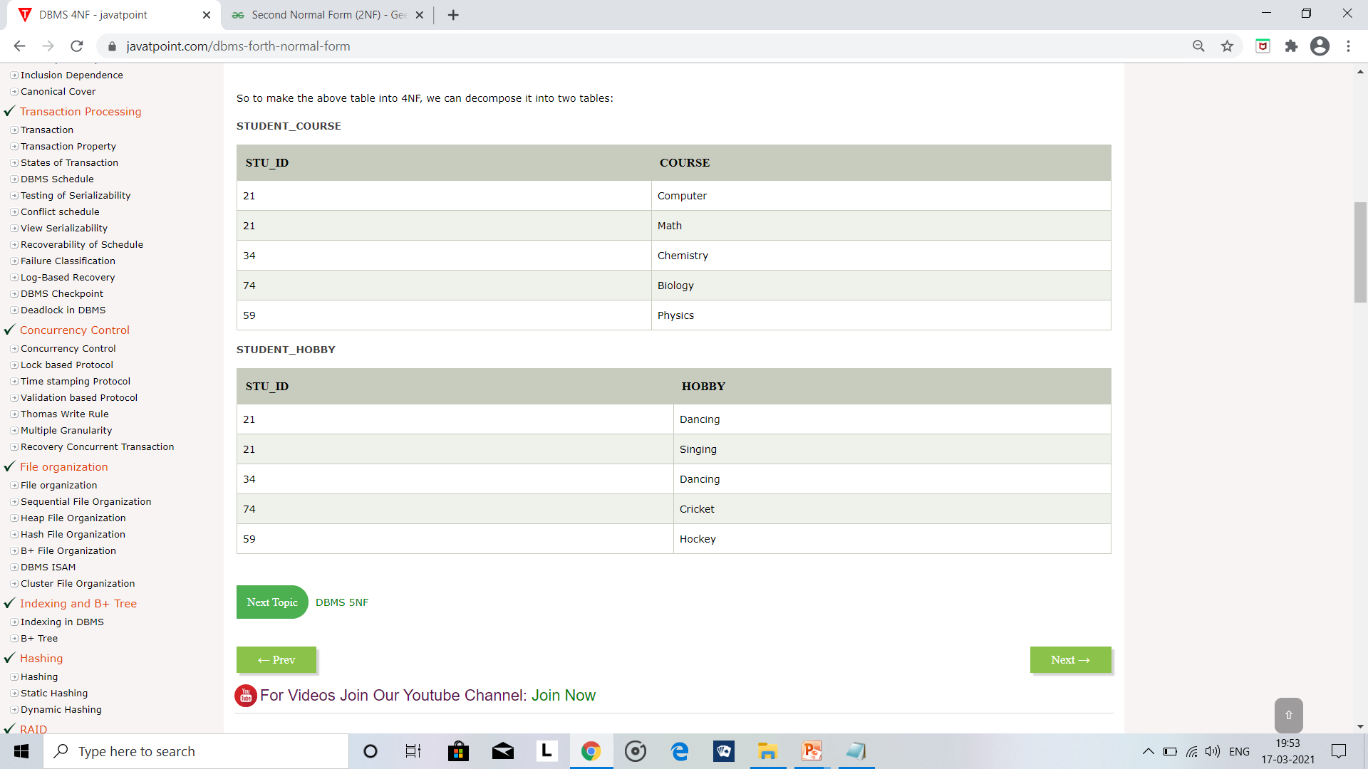
4NF:FOURTH NORMAL FORM
A relation will be in 4NF if it is in Boyce Codd normal form and has no multi-valued dependency.
For a dependency A → B, if for a single value of A, multiple values of B exists, then the relation will be a multi-valued dependency.
EXAMPLE:

Slide 29
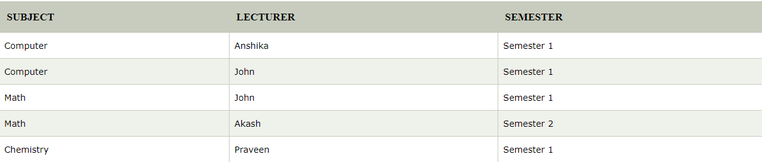
5NF:FIFTH NORMAL FORM
A relation is in 5NF if it is in 4NF and not contains any join dependency and joining should be lossless.
5NF is satisfied when all the tables are broken into as many tables as possible in order to avoid redundancy.
5NF is also known as Project-join normal form (PJ/NF).
EXAMPLE:

Slide 30
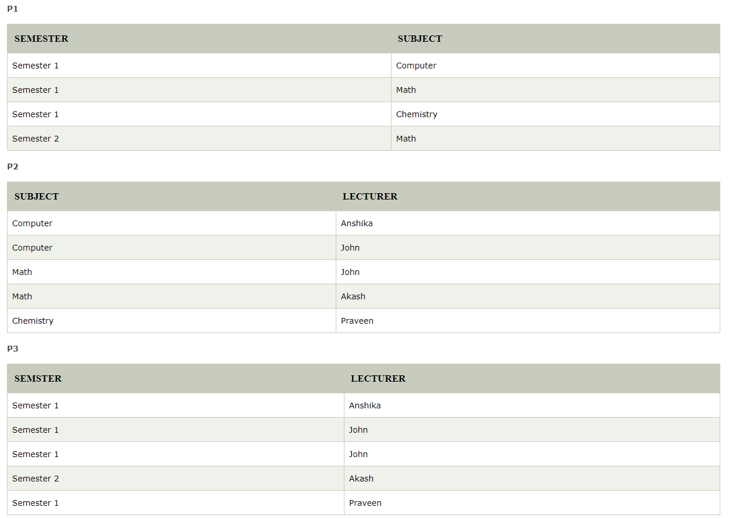
CONTD….

Slide 31
LINGUISTIC
ASPECTS
Abstracted representation of data from its physical storage fostered the ability to create “database views”, which allow the data to be reorganized logically without physically affecting the data.
A view can be as simple as a query to select only certain columns and rows from a single table. Views can also be very complex.
Example, a view might show date-sensitive job cost information by pulling data from multiple tables (and even other views) and performing complex calculations to produce the results.

Slide 32
EXPRESSIBLE, NAMED AND STORED RELATIONS
Named set and expressible set associated with the data bank are two collections of relation
The expressible set is the total collection of relation that can be designated by expression in the data language.
Named set is the collection of all relations that the community of users can identify by means of a simple name( or identifier).
Named set is a subset of the expressible set because usually a very small subset.
Relations that store data are called "base relations", and in implementations are called "tables.

Slide 33
SECTION 2

Slide 34
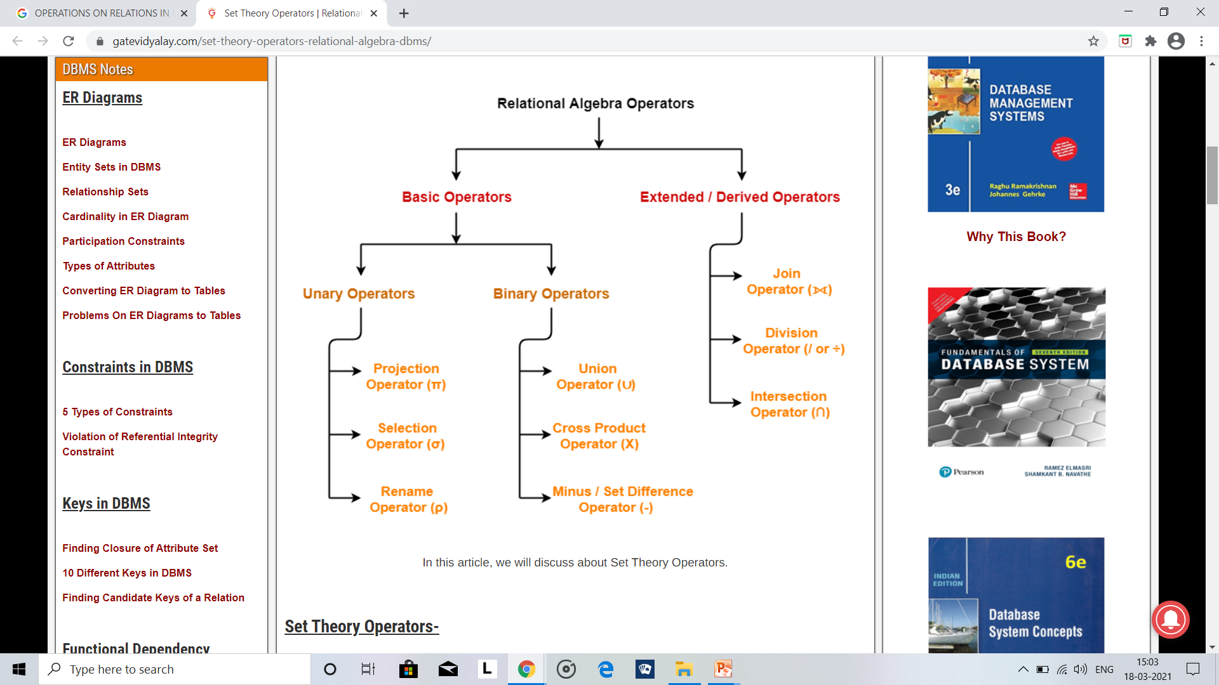
OPERATIONS ON RELATIONS

Slide 35
PERMUTATION
Permutation of a relation R is nothing but interchanging the columns that is going to be another relation R’.
Since we deal with relationship so the order doesn’t matter permutation operation on relation R.
EXAMPLE:
When we have a relation R with 4 columns then 24 relations exists (4! =24).

Slide 36
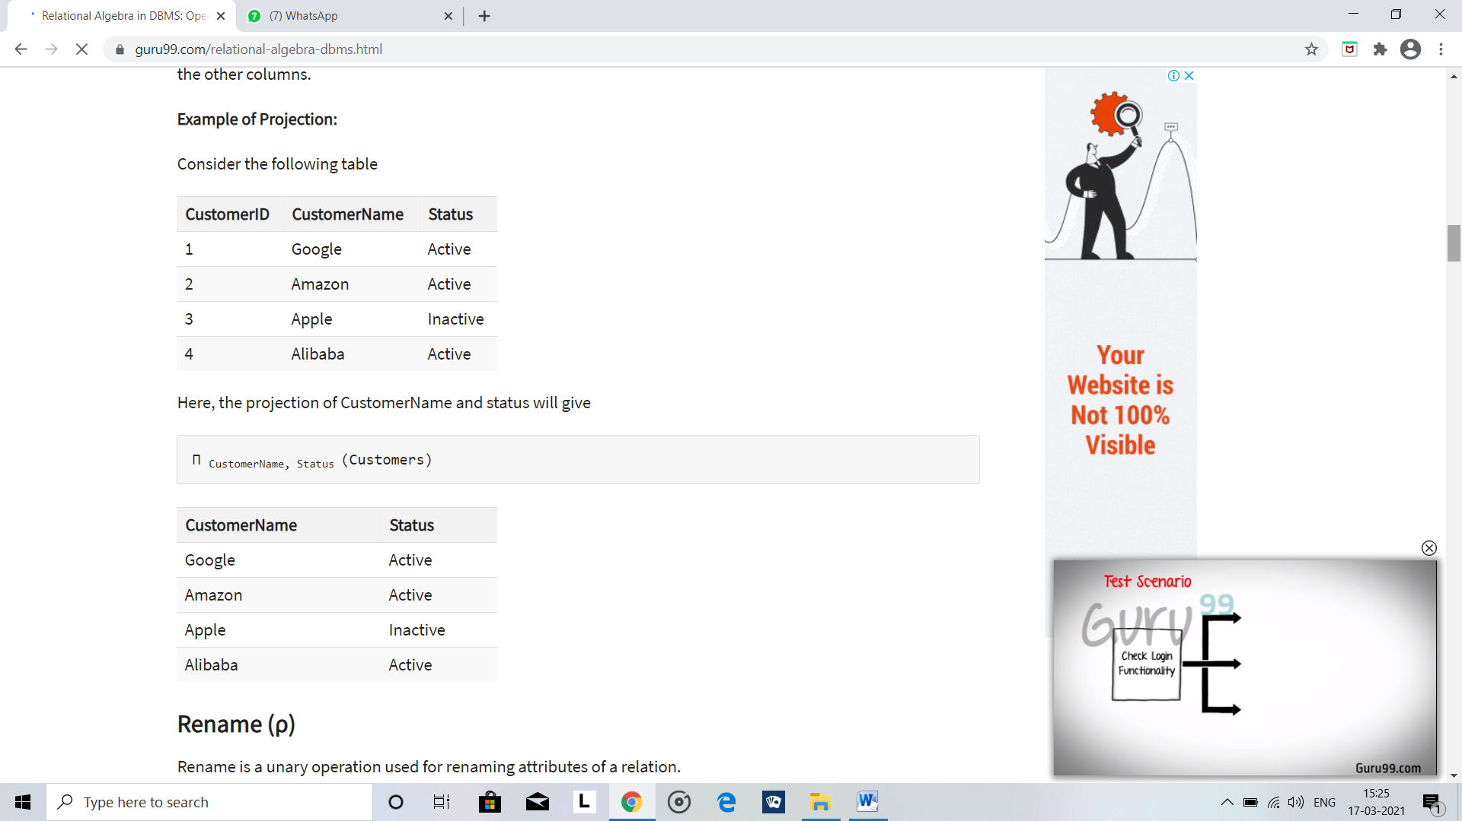
PROJECTION
Presenting a relation R with the required columns (by removing non-required columns ) and rows( by removing the duplicate rows) then, that relation is considered to be projection of relation R.
Here the projection array acts as the subset of the domain or columns of that relation R.
Here the selection operator π symbol is used to choose attributes from a relation.
EXAMPLE:

Slide 37
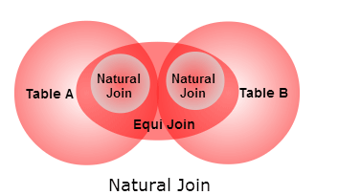
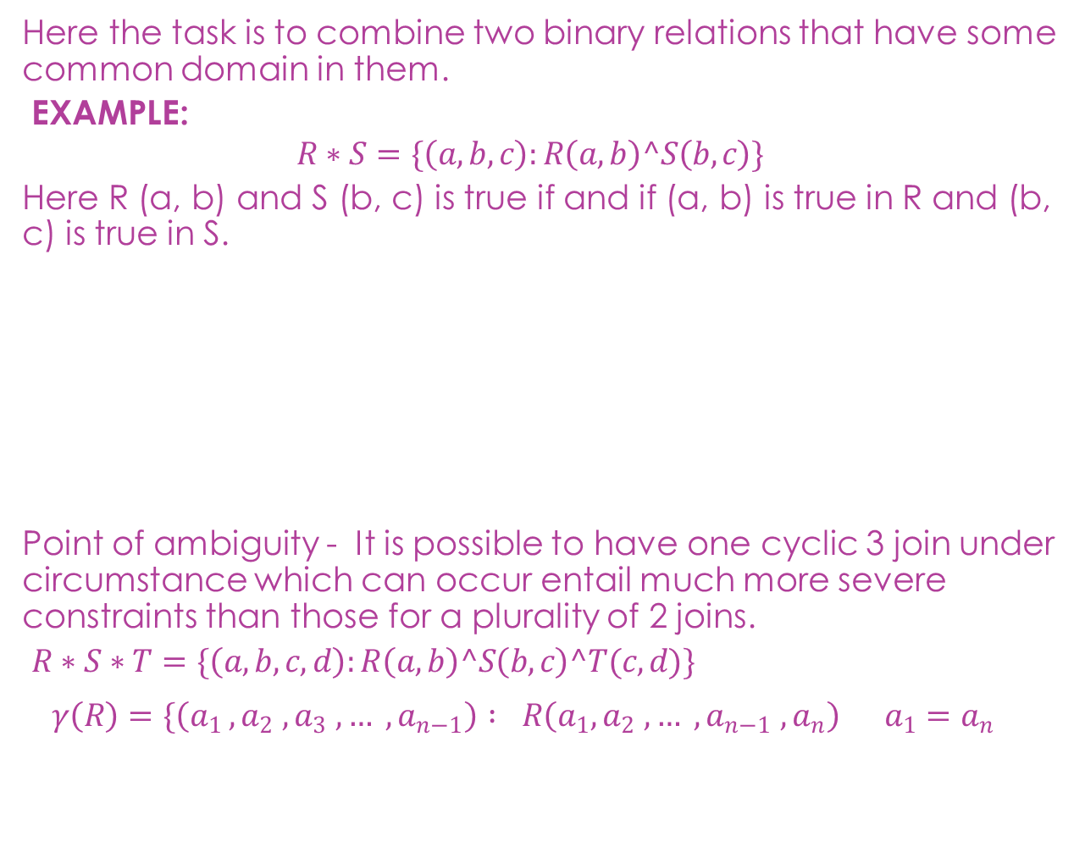
JOINS
Here the task is to combine two binary relations that have some common domain in them.
EXAMPLE:
$$R∗S=\{\left(a,b,c\right):R\left(a,b\right)^S\left(b,c\right)\}$$
Here R (a, b) and S (b, c) is true if and if (a, b) is true in R and (b, c) is true in S.
Point of ambiguity - It is possible to have one cyclic 3 join under circumstance which can occur entail much more severe constraints than those for a plurality of 2 joins.
$R∗S∗T=\{\left(a,b,c,d\right):R\left(a,b\right)^S\left(b,c\right)^T(c,d)\}$
$$γ\left(R\right)=\{\left(a_{1 }, a_{2} , a_{3} , … , a_{n−1}\right) : R{\left(a_{1}, a_{2} , … , a_{n−1} , a_{n}\right)}^{{}^{}}a_{1}=a_{n}$$

Slide 38
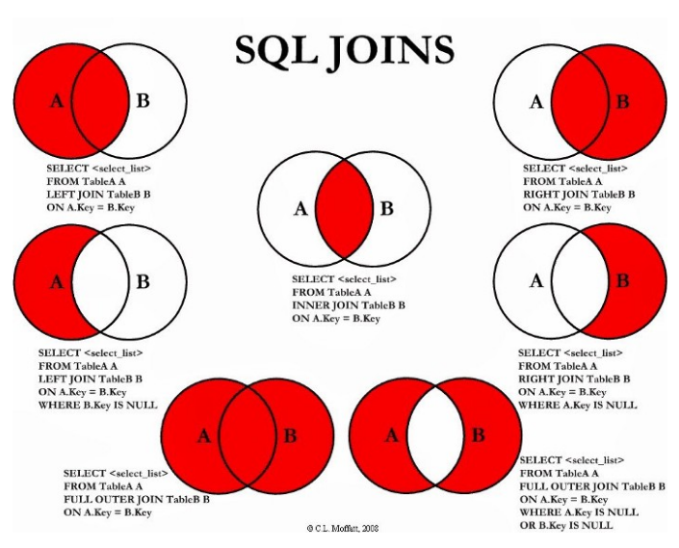
TYPES OF JOINS

Slide 39
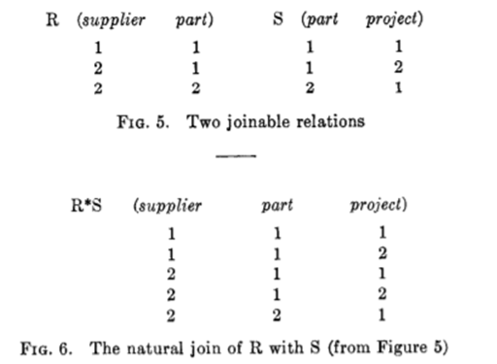
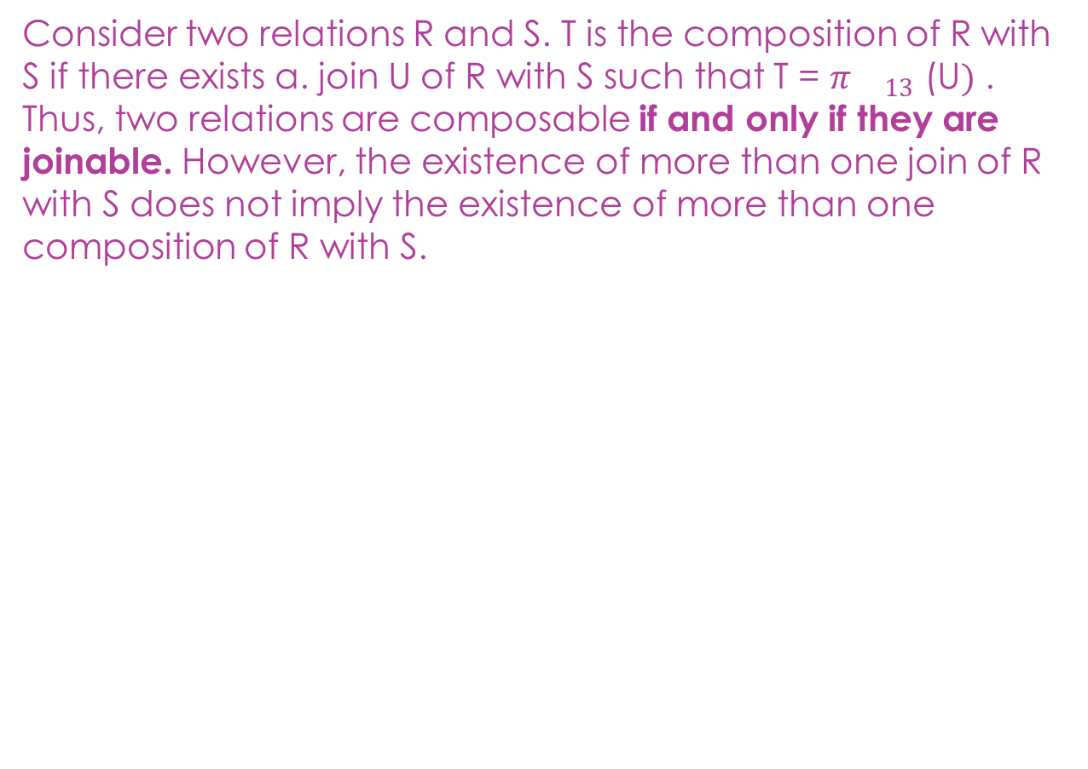
COMPOSITION
Consider two relations R and S. T is the composition of R with S if there exists a. join U of R with S such that T = $π{}_{13}$ (U$)$ . Thus, two relations are composable if and only if they are joinable. However, the existence of more than one join of R with S does not imply the existence of more than one composition of R with S.

Slide 40
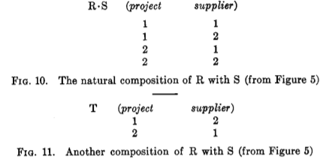
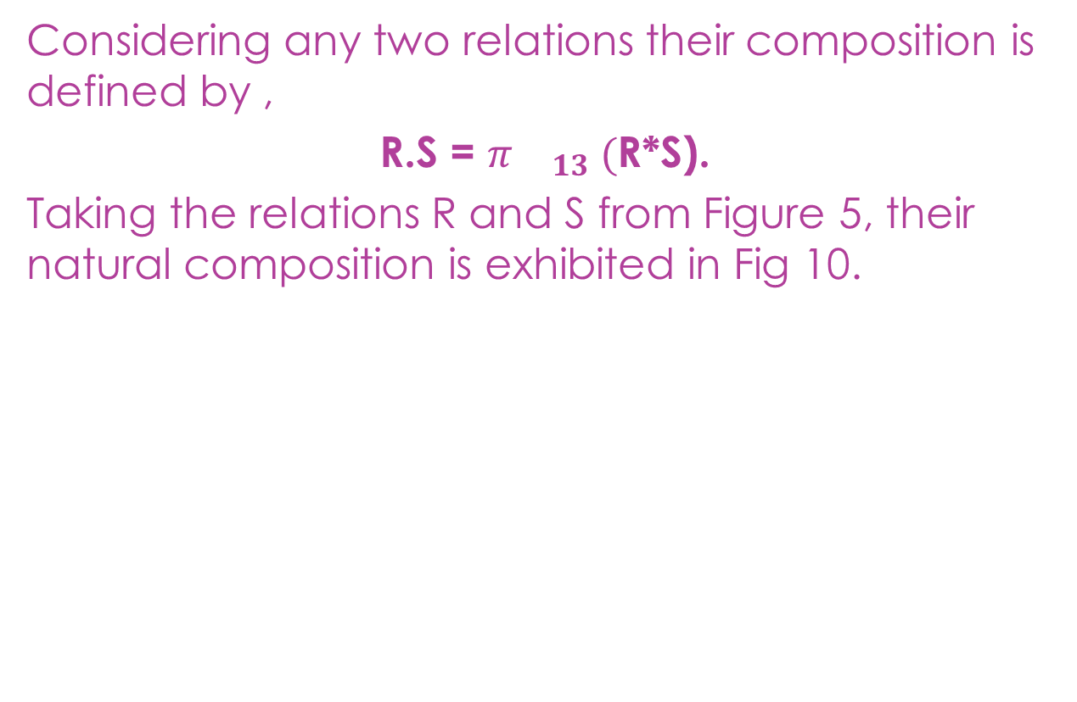
CONTD….
Considering any two relations their composition is defined by ,
R.S = $π{}_{13} ($R*S).
Taking the relations R and S from Figure 5, their natural composition is exhibited in Fig 10.

Slide 41
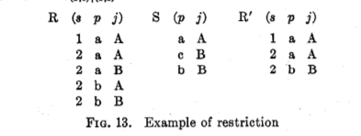
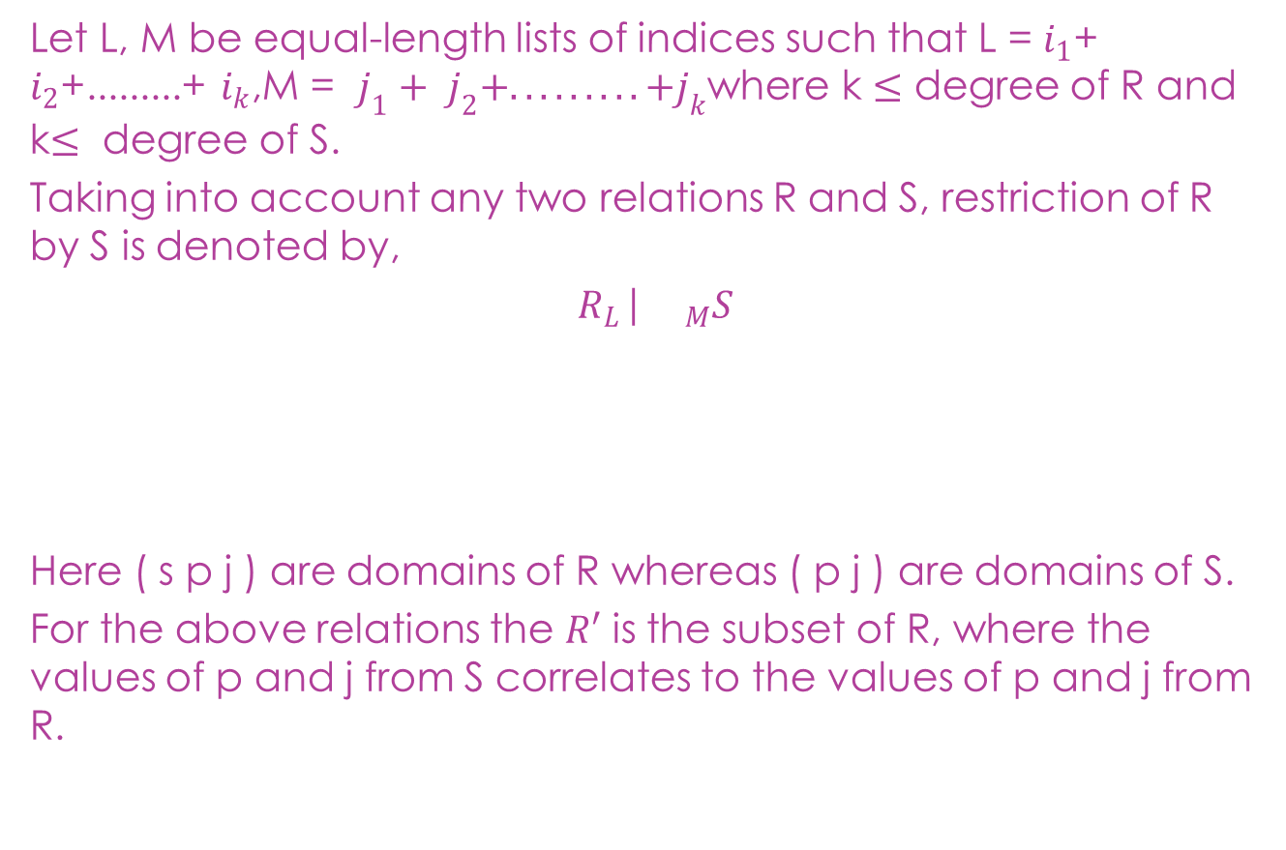
RESTRICTION
Let L, M be equal-length lists of indices such that L = $i_{1}$+ $i_{2}$+.........+ $i_{k}$,M = $j_{1}+ j_{2}+.........+j_{k}$where k $≤$ degree of R and k$≤$ degree of S.
Taking into account any two relations R and S, restriction of R by S is denoted by,
$R_{L}$|${}_{M}S$
Here ( s p j ) are domains of R whereas ( p j ) are domains of S.
For the above relations the $R′$ is the subset of R, where the values of p and j from S correlates to the values of p and j from R.

Slide 42
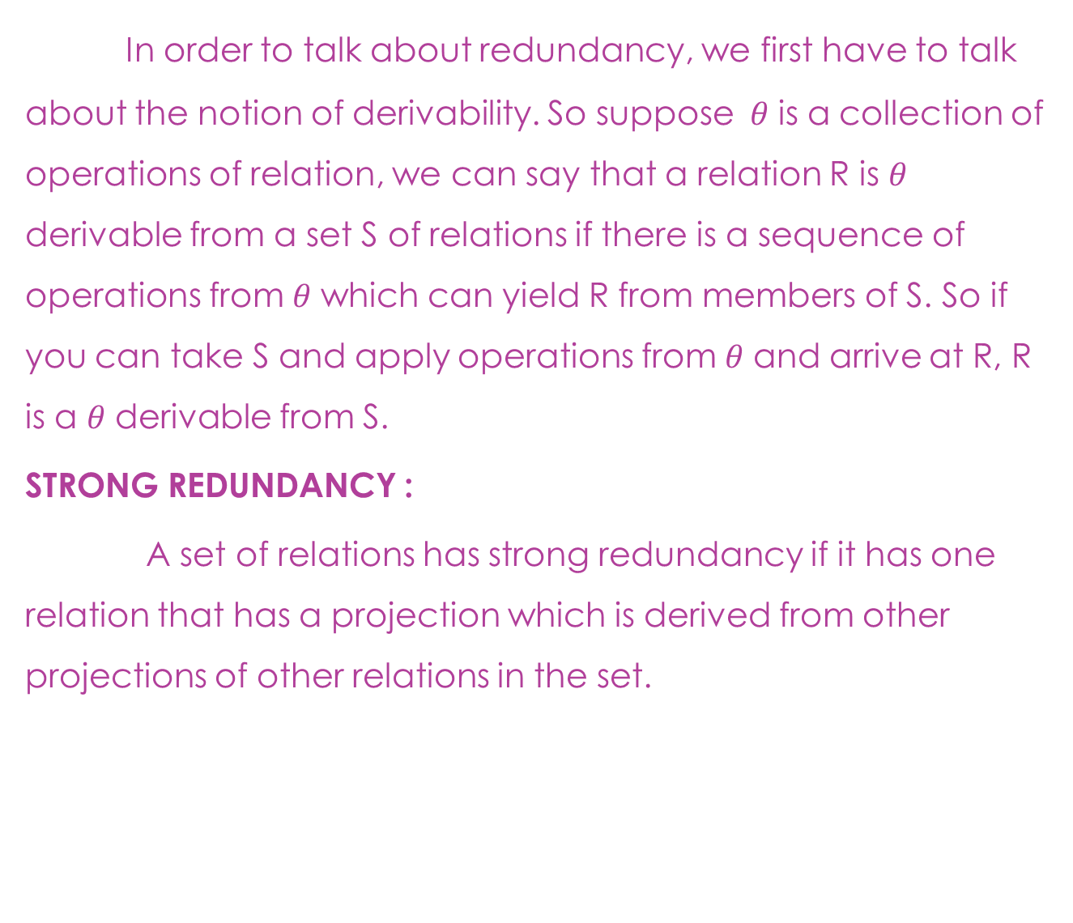
REDUNDANCY
In order to talk about redundancy, we first have to talk about the notion of derivability. So suppose $θ$ is a collection of operations of relation, we can say that a relation R is $θ$ derivable from a set S of relations if there is a sequence of operations from $θ$ which can yield R from members of S. So if you can take S and apply operations from $θ$ and arrive at R, R is a $θ$ derivable from S.
STRONG REDUNDANCY :
A set of relations has strong redundancy if it has one relation that has a projection which is derived from other projections of other relations in the set.

Slide 43
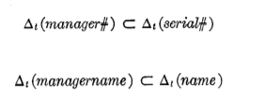
CONTD….
EXAMPLE: If we have a relation employee which has columns for serial number, name, manager number and manager name.
The column for manager name is redundant because it is a subset of name and given manager number as the key we can look up for it in our employee relation itself to arrive at a name of the manager.
We mostly have strong redundancy in the relation for user convenience and also because old programs can refer obsolete relationships in the nameset.
WEAK REDUNDANCY :
A notion of weak redundancy which is when a set of relations contains a relation that is not derived from other members but arrived from some join of projection from relations in this collection.
In other words, if you have a table that is derived above by a join operation from other tables in that set of relation, that table is weakly redundant.

Slide 44
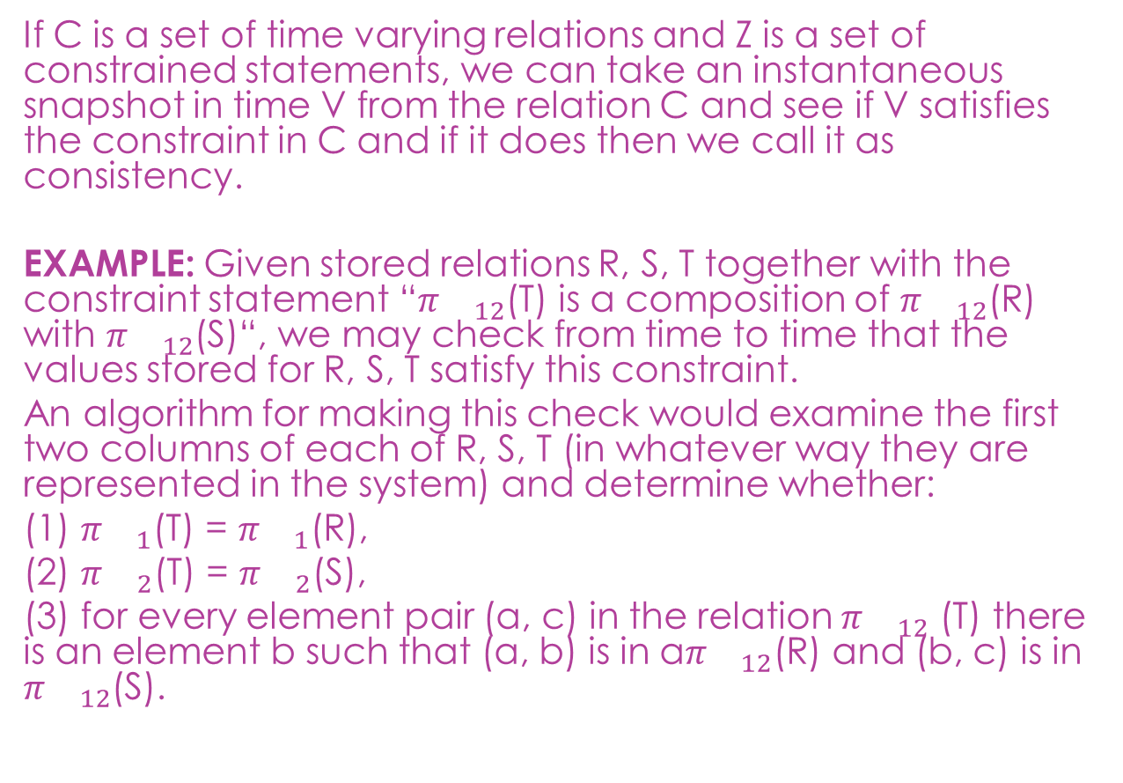
CONSISTENCY
If C is a set of time varying relations and Z is a set of constrained statements, we can take an instantaneous snapshot in time V from the relation C and see if V satisfies the constraint in C and if it does then we call it as consistency.
EXAMPLE: Given stored relations R, S, T together with the constraint statement “$π{}_{12}$(T) is a composition of $π{}_{12}$(R) with $π{}_{12}$(S)“, we may check from time to time that the values stored for R, S, T satisfy this constraint.
An algorithm for making this check would examine the first two columns of each of R, S, T (in whatever way they are represented in the system) and determine whether:
(1) $π{}_{1}$(T) = $π{}_{1}$(R),
(2) $π{}_{2}$(T) = $π{}_{2}$(S),
(3) for every element pair (a, c) in the relation $π{}_{12}$ (T) there is an element b such that (a, b) is in a$π{}_{12}$(R) and (b, c) is in $π{}_{12}$(S).

Slide 45
CONTD….
There are practical problems in taking an instantaneous snapshot of a collection of relations, some of which may be very large and highly variable.
There are, of course, several possible ways in which a system can detect inconsistencies and respond to them.
In one approach the system checks for possible inconsistency whenever an insertion, deletion, or key update occurs. Naturally, such checking will slow these operations down. If an inconsistency has been generated, details are logged internally, and if it is not remedied within some reasonable time interval, either the user or someone responsible for the security and integrity of the data is notified.
Another approach is to conduct consistency checking as a batch operation once a day or less frequently. Inputs causing the inconsistencies which remain in the data bank state at checking time can be tracked down if the system maintains a journal of all state-changing transactions. This latter approach would certainly be superior if few non transitory inconsistencies occurred.

Slide 46
CONCLUSION
Relational database management system (RDBMS) soon become very popular, especially for their ease of use and flexibility in structure. This is all about relational data model and its widely used to design the database systems.
In section 1, a time-varying collection of relationship is introduced as normal form as well as data representation caused by growth and change in traffic in a data bank.
In section 2, operation of relation and types of redundancy are defined and applied in the data bank.

Slide 47
THANK YOU

